Slide 1
MARGINAL AND CONDITIONAL PROBABILITIES
Suppose all 100 employees of a company were asked whether they are in favor of or against paying high salaries to CEOs of U.S. companies. Table 4.3 gives a two way classification of the responses of these 100 employees.

Slide 2
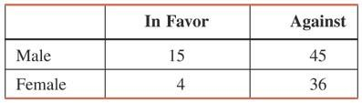
Table 4.3 Two-Way Classification of Employee Responses

Slide 3
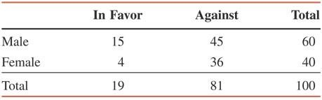
Table 4.4 Two-Way Classification of Employee Responses with Totals

Slide 4
MARGINAL AND CONDITIONAL PROBABILITIES
Definition
Marginal probability is the probability of a single event without consideration of any other event. Marginal probability is also called simple probability.

Slide 5
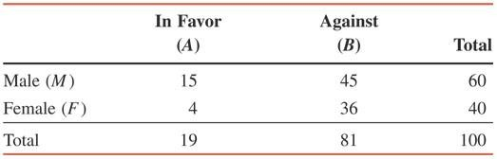
Table 4.5 Listing the Marginal Probabilities
P (M ) = 60/100 = .60
P (F ) = 40/100 = .40
P (A ) = 19/100
= .19
P (B ) = 81/100
= .81

Slide 6

MARGINAL AND CONDITIONAL PROBABILITIES

Slide 7
MARGINAL AND CONDITIONAL PROBABILITIES
Definition
Conditional probability is the probability that an event will occur given that another has already occurred. If A and B are two events, then the conditional probability A given B is written as
P ( A | B )
and read as “the probability of A given that B has
already occurred.”

Slide 8
Example 4-15
Compute the conditional probability
P ( in favor | male) for the data on 100 employees given in Table 4.4.

Slide 9
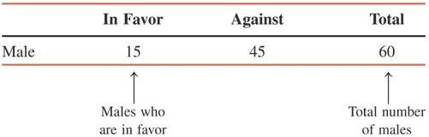
Example 4-15: Solution
_{P(in favor | male) =} Number of males who are in favor ₌ 15 _{= .25}
Total number of males 60

Slide 10
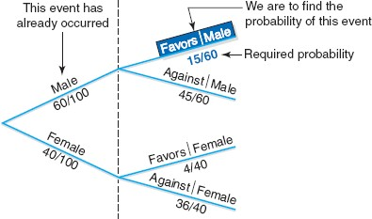
Figure 4.6 Tree Diagram.

Slide 11
Example 4-16
For the data of Table 4.4, calculate the conditional probability that a randomly selected employee is a female given that this employee is in favor of paying high salaries to CEOs.

Slide 12
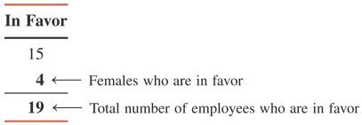
Example 4-16: Solution
Number of females who are in favor
P(female| in favor) =
Total number of employeeswho are in favor
= ⁴ = .2105
19

Slide 13
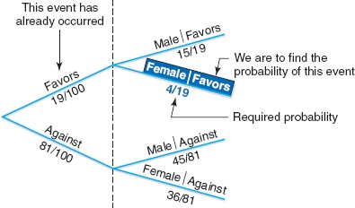
Figure 4.7 Tree diagram.

Slide 14
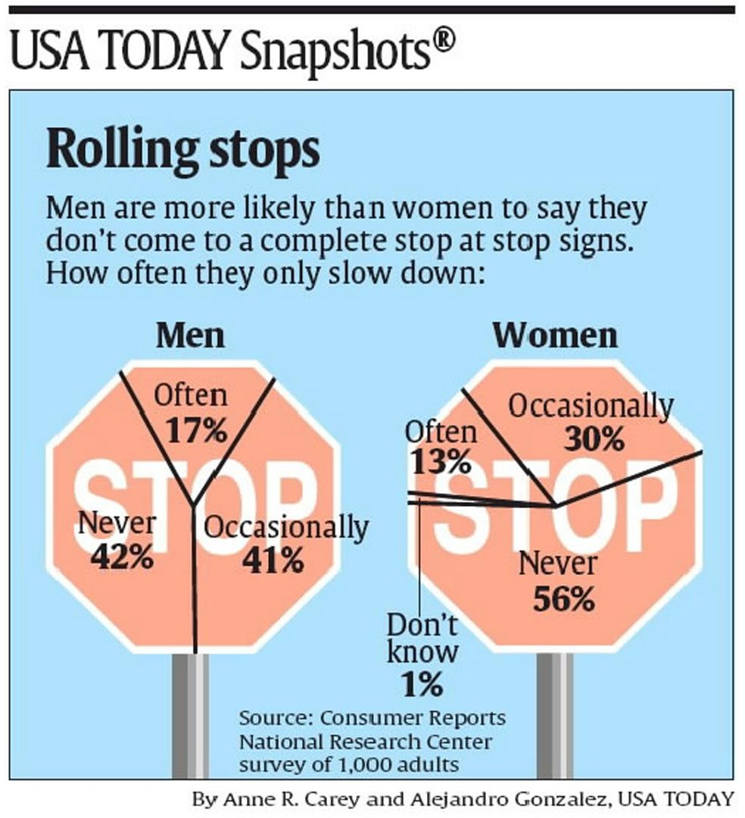
Case Study 4-1 Rolling Stops

Slide 15
MUTUALLY EXCLUSIVE EVENTS
Definition
Events that cannot occur together are said to be mutually exclusive events.

Slide 16
Example 4-17
Consider the following events for one roll of a die:
A= an even number is observed= {2, 4, 6}
B= an odd number is observed= {1, 3, 5}
C= a number less than 5 is observed= {1, 2, 3, 4}
Are events A and B mutually exclusive? Are events A and C mutually exclusive?

Slide 17
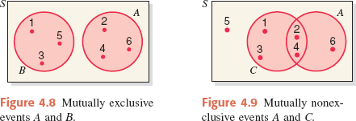
Example 4-17: Solution

Slide 18
Example 4-18
Consider the following two events for a randomly selected adult:
Y = this adult has shopped on the Internet at least once
N = this adult has never shopped on the Internet
Are events Y and N mutually exclusive?

Slide 19
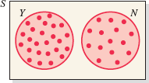
Example 4-18: Solution
As we can observe from the definitions of events Y and N and from Figure 4.10, events Y and N have no common outcome. Hence, these two events are mutually exclusive.

Slide 20
INDEPENDENT VERSUS DEPENDENT EVENTS
Definition
Two events are said to be independent if the occurrence of one does not affect the probability of the occurrence of the other. In other words, A and B are independent events if
either P(A | B) = P(A) or P(B | A) = P(B)

Slide 21
Example 4-19
Refer to the information on 100 employees given in Table 4.4 in Section 4.4. Are events “female (F)” and “in favor (A)” independent?

Slide 22
Example 4-19: Solution
Events F and A will be independent if
P (F) = P (F | A)
Otherwise they will be dependent.
Using the information given in Table 4.4, compute
P (F) = 40/100 = .40 and
P (F | A) = 4/19 = .2105
Because these two probabilities are not equal, the two events are dependent.

Slide 23
Example 4-20
A box contains a total of 100 CDs that were manufactured on two machines. Of them, 60 were manufactured on Machine I. Of the total CDs, 15 are defective. Of the 60 CDs that were manufactured on Machine I, 9 are defective.
Let D be the event that a randomly selected CD is defective, and let A be the event that a randomly selected CD was manufactured on Machine I. Are events D and A independent?

Slide 24
Example 4-20: Solution
From the given information,
P (D) = 15/100 = .15 and
P (D | A) = 9/60 = .15
Hence,
P (D) = P (D | A)
Consequently, the two events, D and A, are independent.

Slide 25
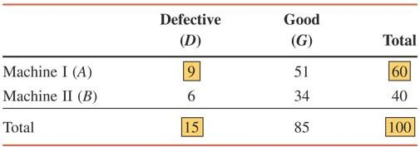
Table 4.6 Two-Way Classification Table

Slide 26

COMPLEMENTARY EVENTS
Definition
The complement of event A, denoted by Ā and is read as “A bar” or “A complement,” is the event that includes all the outcomes for an experiment that are not in A.

Slide 27
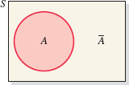
Figure 4.11 Venn diagram of two complementary events.

Slide 28
Example 4-21
In a group of 2000 taxpayers, 400 have been audited by the IRS at least once. If one taxpayer is randomly selected from this group, what are the two complementary events for this experiment, and what are their probabilities?

Slide 29
Example 4-21: Solution
The two complementary events for this experiment are
A = the selected taxpayer has been audited by the IRS at least once
Ā = the selected taxpayer has never been audited by the
IRS
The probabilities of the complementary events are
P (A) = 400/2000 = .20 and
P (Ā) = 1600/2000 = .80

Slide 30

Figure 4.12 Venn diagram.

Slide 31
Example 4-22
In a group of 5000 adults, 3500 are in favor of stricter gun control laws, 1200 are against such laws, and 300 have no opinion. One adult is randomly selected from this group. Let A be the event that this adult is in favor of stricter gun control laws. What is the complementary event of A? What are the probabilities of the two events?

Slide 32
Example 4-22: Solution
The two complementary events for this experiment are
A = the selected adult is in favor of stricter gun control laws
Ā = the selected adult either is against such laws or has
no opinion
The probabilities of the complementary events are
P (A) = 3500/5000 = .70 and
P (Ā) = 1500/5000 = .30

Slide 33
Figure 4.13 Venn diagram.

Slide 34
INTERSECTION OF EVENTS AND THE MULTIPLICATION RULE
Intersection of Events
Definition
Let A and B be two events defined in a sample space. The intersection of A and B represents the collection of all outcomes that are common to both A and B and is denoted by
A and B

Slide 35
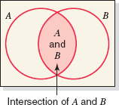
Figure 4.14 Intersection of events A and B.

Slide 36
INTERSECTION OF EVENTS AND THE MULTIPLICATION RULE
Multiplication Rule
Definition
The probability of the intersection of two events is called their joint probability. It is written as
P(A and B)

Slide 37
INTERSECTION OF EVENTS AND THE MULTIPLICATION RULE
Multiplication Rule to Find Joint Probability
The probability of the intersection of two events A and B is
P(A and B) = P(A) P(B |A)

Slide 38
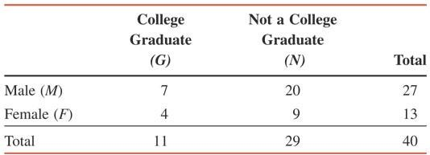
Example 4-23
Table 4.7 gives the classification of all employees of a company given by gender and college degree.

Slide 39
Example 4-23
If one of these employees is selected at random for membership on the employee- management committee, what is the probability that this employee is a female and a college graduate?

Slide 40
Example 4-23: Solution
We are to calculate the probability of the intersection of the events F and G.
P(F and G) = P(F) P(G |F)
P(F) = 13/40
P(G |F) = 4/13
P(F and G) = P(F) P(G |F)
= (13/40)(4/13) = .100

Slide 41
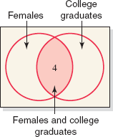
Figure 4.15 Intersection of events F and G.

Slide 42
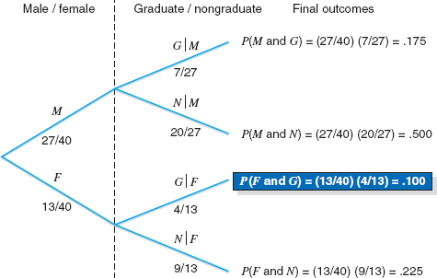
Figure 4.16 Tree diagram for joint probabilities.

Slide 43
Example 4-24
A box contains 20 DVDs, 4 of which are defective. If two DVDs are selected at random (without replacement) from this box, what is the probability that both are defective?

Slide 44
Example 4-24: Solution
Let us define the following events for this
experiment:
G₁ = event that the first DVD selected is good
D₁ = event that the first DVD selected is defective
G₂ = event that the second DVD selected is good
D₂ = event that the second DVD selected is defective
We are to calculate the joint probability of D₁ and D₂,
P(D₁ and D₂) = P(D₁) P(D₂ |D₁)
P(D₁) = 4/20
P(D₂ |D₁) = 3/19
P(D₁ and D₂) = (4/20)(3/19) = .0316

Slide 45
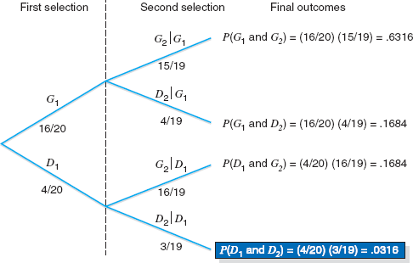
Figure 4.17 Selecting two DVDs.

Slide 46
INTERSECTION OF EVENTS AND THE MULTIPLICATION RULE
Calculating Conditional Probability
If A and B are two events, then,
P(B | A) = ^{P( A and B)} and P( A | B) = ^{P( A and B)} P( A) P(B)
given that P (A ) ≠ 0 and P (B ) ≠ 0.

Slide 47
Example 4-25
The probability that a randomly selected student from a college is a senior is .20, and the joint probability that the student is a computer science major and a senior is .03. Find the conditional probability that a student selected at random is a computer science major given that the student is a senior.

Slide 48
Example 4-25: Solution
Let us define the following two events:
A = the student selected is a senior
B = the student selected is a computer science major
From the given information,
P(A) = .20 and P(A and B) = .03
Hence,
P (B | A) = P(A and B)/P(A) = .03/.20 = .15

Slide 49
Multiplication Rule for Independent Events
Multiplication Rule to Calculate the Probability of Independent Events
The probability of the intersection of two independent events A and B is
P(A and B) = P(A) P(B)

Slide 50
Example 4-26
An office building has two fire detectors. The probability is .02 that any fire detector of this type will fail to go off during a fire. Find the probability that both of these fire detectors will fail to go off in case of a fire.

Slide 51
Example 4-26: Solution
We define the following two events:
A = the first fire detector fails to go off during a fire
B = the second fire detector fails to go off during a fire
Then, the joint probability of A and B is
P(A and B) = P(A) P(B) = (.02)(.02) = .0004

Slide 52
Example 4-27
The probability that a patient is allergic to penicillin is .20. Suppose this drug is administered to three patients.
Find the probability that all three of them are allergic to it.
Find the probability that at least one of the them is not allergic to it.

Slide 53
Example 4-27: Solution
a) Let A, B, and C denote the events the first, second and third patients, respectively, are allergic to penicillin. Hence,
P (A and B and C) = P(A) P(B) P(C)
= (.20) (.20) (.20) = .008

Slide 54
Example 4-27: Solution
b) Let us define the following events:
G = all three patients are allergic
H = at least one patient is not allergic
P(G) = P(A and B and C) = .008
Therefore, using the complementary event rule, we obtain
P(H) = 1 – P(G) = 1 - .008 = .992

Slide 55
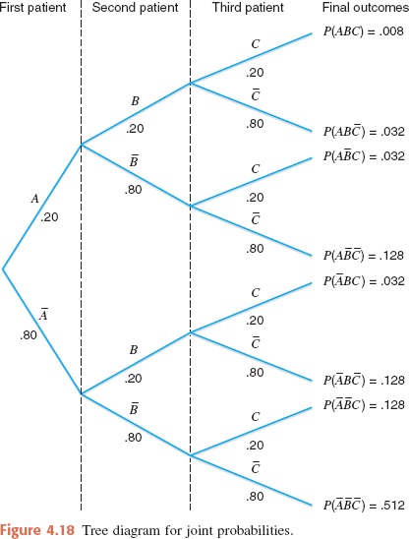
Figure 4.18 Tree diagram for joint probabilities.

Slide 56
Multiplication Rule for Independent Events
Joint Probability of Mutually Exclusive Events
The joint probability of two mutually exclusive events is always zero. If A and B are two mutually exclusive events, then
P(A and B) = 0

Slide 57
Example 4-28
Consider the following two events for an application filed by a person to obtain a car loan:
A = event that the loan application is approved
R = event that the loan application is rejected
What is the joint probability of A and R?

Slide 58
Example 4-28: Solution
The two events A and R are mutually exclusive. Either the loan application will be approved or it will be rejected. Hence,
P(A and R) = 0

Slide 59
UNION OF EVENTS AND THE ADDITION RULE
Definition
Let A and B be two events defined in a sample space. The union of events A and B is the collection of all outcomes that belong to either A or B or to both A and B and is denoted by
A or B

Slide 60
Example 4-29
A senior citizen center has 300 members. Of them, 140 are male, 210 take at least one medicine on a permanent basis, and 95 are male and take at least one medicine on a permanent basis. Describe the union of the events “male” and “take at least one medicine on a permanent basis.”

Slide 61
Example 4-29: Solution
Let us define the following events:
M = a senior citizen is a male
F = a senior citizen is a female
A = a senior citizen takes at least one medicine
B = a senior citizen does not take any medicine
The union of the events “male” and “take at least one medicine” includes those senior citizens who are either male or take at least one medicine or both. The number of such senior citizen is
140 + 210 – 95 = 255

Slide 62
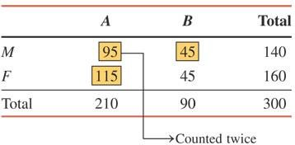
Table 4.8

Slide 63
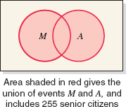
Figure 4.19 Union of events M and A.

Slide 64
UNION OF EVENTS AND THE ADDITION RULE
Addition Rule
Addition Rule to Find the Probability of Union of Events
The portability of the union of two events A
and B is
P(A or B) = P(A) + P(B) – P(A and B)

Slide 65
Example 4-30
A university president has proposed that all students must take a course in ethics as a requirement for graduation. Three hundred faculty members and students from this university were asked about their opinion on this issue. Table 4.9 gives a two-way classification of the responses of these faculty members and students.
Find the probability that one person selected at random from these 300 persons is a faculty member or is in favor of this proposal.

Slide 66
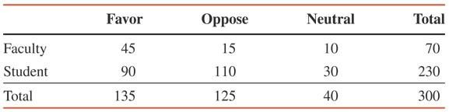
Table 4.9 Two-Way Classification of Responses

Slide 67
Example 4-30: Solution
Let us define the following events:
A = the person selected is a faculty member
B = the person selected is in favor of the proposal
From the information in the Table 4.9,
P(A) = 70/300 = .2333
P(B) = 135/300 = .4500
P(A and B) = P(A) P(B | A) = (70/300)(45/70) = .1500
Using the addition rule, we obtain
P(A or B) = P(A) + P(B) – P(A and B)
= .2333 + .4500 – .1500 = .5333

Slide 68
Example 4-31
In a group of 2500 persons, 1400 are female, 600 are vegetarian, and 400 are female and vegetarian. What is the probability that a randomly selected person from this group is a male or vegetarian?

Slide 69
Example 4-31: Solution
Let us define the following events:
F = the randomly selected person is a female M = the randomly selected person is a male
V = the randomly selected person is a vegetarian
N = the randomly selected person is a non-vegetarian.
P(M or V ) = P(M ) + P(V ) − P(M and V )
₌ 1100 ₊ 600 ₋ 200
2500 2500 2500
= .44 +.24 −.08 = .60

Slide 70
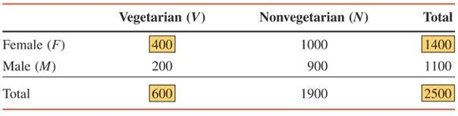
Table 4.10 Two-Way Classification Table

Slide 71
Addition Rule for Mutually Exclusive Events
Addition Rule to Find the Probability of the Union of Mutually Exclusive Events
The probability of the union of two mutually exclusive events A and B is
P(A or B) = P(A) + P(B)

Slide 72
Example 4-32
A university president has proposed that all students must take a course in ethics as a requirement for graduation. Three hundred faculty members and students from this university were asked about their opinion on this issue. The following table, reproduced from Table 4.9 in Example 4-30, gives a two-way classification of the responses of these faculty members and students.
What is the probability that a randomly selected person from these 300 faculty members and students is in favor of the proposal or is neutral?

Slide 73
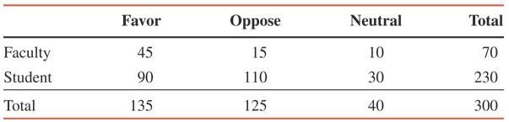
Example 4-32: Solution

Slide 74
Example 4-32: Solution
Let us define the following events:
F = the person selected is in favor of the proposal
N = the person selected is neutral
From the given information,
P(F) = 135/300 = .4500
P(N) = 40/300 = .1333
Hence,
P(F or N) = P(F) + P(N) = .4500 + .1333 = .5833

Slide 75

Figure 4.20 Venn diagram of mutually exclusive events.

Slide 76
Example 4-33
Consider the experiment of rolling a die twice. Find the probability that the sum of the numbers obtained on two rolls is 5, 7, or 10.

Slide 77
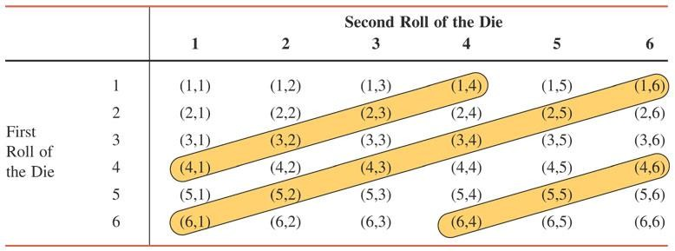
Table 4.11 Two Rolls of a Die

Slide 78
Example 4-33: Solution
P(sum is 5 or 7 or 10)
= P(sum is 5) + P(sum is 7) + P(sum is 10)
= 4/36 + 6/36 + 3/36 = 13/36 = .3611

Slide 79
Example 4-34
The probability that a person is in favor of genetic engineering is .55 and that a person is against it is .45. Two persons are randomly selected, and it is observed whether they favor or oppose genetic engineering.
Draw a tree diagram for this experiment
Find the probability that at least one of the two persons favors genetic engineering.

Slide 80
Example 4-34: Solution
a) Let
F = a person is in favor of genetic engineering
A = a person is against genetic engineering
This experiment has four outcomes. The tree diagram in Figure 4.21 shows these four outcomes and their probabilities.

Slide 81
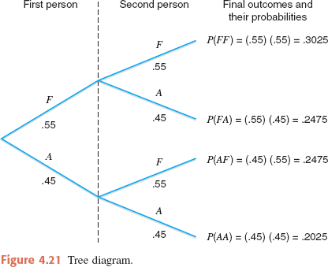
Figure 4.21 Tree diagram.

Slide 82
Example 4-34: Solution
b) P(at least one person favors)
= P(FF or FA or AF)
= P(FF) + P(FA) + P(AF)
= .3025 + .2475 + .2475 = .7975

Slide 83
72
Chapter 2 Probability
2.7 Bayes’ Rule
Bayesian statistics is a collection of tools that is used in a special form of statistical inference which applies in the analysis of experimental data in many practical situations in science and engineering. Bayes’ rule is one of the most important rules in probability theory. It is the foundation of Bayesian inference, which will be discussed in Chapter 18.
Total Probability
Let us now return to the illustration of Section 2.6, where an individual is being selected at random from the adults of a small town to tour the country and publicize the advantages of establishing new industries in the town. Suppose that we are now given the additional information that 36 of those employed and 12 of those unemployed are members of the Rotary Club. We wish to ﬁnd the probability of the event A that the individual selected is a member of the Rotary Club. Referring to Figure 2.12, we can write A as the union of the two mutually exclusive events E ∩A and E′ ∩A. Hence, A = (E ∩A) ∪ (E′ ∩A), and by Corollary 2.1 of Theorem 2.7, and then Theorem 2.10, we can write
P (A) = P [(E ∩ A) ∪ (E′ ∩ A)] = P (E ∩ A)+ P (E′ ∩ A)
= P (E)P (A|E)+ P (E′)P (A|E′).
E
A
E '
E ∩ A
E ' ∩ A
Figure 2.12: Venn diagram for the events A, E, and E′.
The data of Section 2.6, together with the additional data given above for the set
A, enable us to compute
600 2 36 3
P (E) = = , P (A|E) = = ,
900 3 600 50
and
1 12 1
′ ′
P (E ) = , P (A|E ) = = .
3 300 25
If we display these probabilities by means of the tree diagram of Figure 2.13, where the ﬁrst branch yields the probability P (E)P (A|E) and the second branch yields

Slide 84
2.7 Bayes’ Rule
73
E P(A|E) = 3/50 A P(E)P(A|E)
P(E')P(A|E')
E' P(A|E)' = 1/25 A'
P(E) = 2/3
P(E') = 1/3
Figure 2.13: Tree diagram for the data on page 63, using additional information on page 72.
the probability P (E′)P (A|E′), it follows that
2 3 1 1
4
= .
P (A) =
+
3 50 3 25 75
A generalization of the foregoing illustration to the case where the sample space is partitioned into k subsets is covered by the following theorem, sometimes called the theorem of total probability or the rule of elimination.
Theorem 2.13: If the events B₁, B₂,..., B_{k} constitute a partition of the sample space S such that
P (B_{i}) = 0 for i = 1, 2,..., k, then for any event A of S,
k k
Σ Σ
P (A) = P (B ∩ A) = P (B )P (A|B ).
i i
i
i=1 i=1
B ₃
B ₁
B ₄
B ₅
A
B ₂
…
Figure 2.14: Partitioning the sample space S.

Slide 85
74
Chapter 2 Probability
Proof : Consider the Venn diagram of Figure 2.14. The event A is seen to be the union of the mutually exclusive events
B₁ ∩ A, B₂ ∩ A, ..., B_{k} ∩ A;
that is,
A = (B₁ ∩ A) ∪ (B₂ ∩ A) ∪·· · ∪ (B_{k} ∩ A).
Using Corollary 2.2 of Theorem 2.7 and Theorem 2.10, we have
P (A) = P [(B₁ ∩ A) ∪ (B₂ ∩ A) ∪·· · ∪ (B_{k} ∩ A)]
= P (B₁ ∩ A)+ P (B₂ ∩ A)+ ··· + P (B_{k} ∩ A)
k
Σ
= P (B ∩ A)
i=1
i
k
Σ
= P (B )P (A
|B ).
i
i
i=1
Example 2.41: In a certain assembly plant, three machines, B₁, B₂, and B₃, make 30%, 45%, and 25%, respectively, of the products. It is known from past experience that 2%, 3%, and 2% of the products made by each machine, respectively, are defective. Now, suppose that a ﬁnished product is randomly selected. What is the probability that it is defective?
Solution : Consider the following events:
A: the product is defective,
B₁: the product is made by machine B₁, B₂: the product is made by machine B₂, B₃: the product is made by machine B₃.
Applying the rule of elimination, we can write
P (A) = P (B₁)P (A|B₁)+ P (B₂)P (A|B₂)+ P (B₃)P (A|B₃).
Referring to the tree diagram of Figure 2.15, we ﬁnd that the three branches give the probabilities
P (B₁)P (A|B₁) = (0.3)(0.02) = 0.006,
P (B₂)P (A|B₂) = (0.45)(0.03) = 0.0135,
P (B₃)P (A|B₃) = (0.25)(0.02) = 0.005,
and hence
P (A) = 0.006 + 0.0135 + 0.005 = 0.0245.

Slide 86
2.7 Bayes’ Rule
75
B ₁ P(A | B 1 ) = 0.02 A
P(B ₂ ) = 0.45 P(A | B ₂ ) = 0.03 A
B ₂
A
B ₃ P(A | B ₃ ) = 0.02
) = 0.3
P(B
1
P(B
3
) = 0.25
Figure 2.15: Tree diagram for Example 2.41.
Bayes’ Rule
Instead of asking for P (A) in Example 2.41, by the rule of elimination, suppose that we now consider the problem of ﬁnding the conditional probability P (B_{i}|A). In other words, suppose that a product was randomly selected and it is defective. What is the probability that this product was made by machine B_{i}? Questions of this type can be answered by using the following theorem, called Bayes’ rule:
Theorem 2.14: (Bayes’ Rule) If the events B1, B2,..., Bk constitute a partition of the sample space S such that P (B_{i}) = 0 for i = 1, 2,..., k, then for any event A in S such that P (A) /= 0,
P (B ∩
A) P (B )P (A|B )
P (B |A) =
r
=
r
r
for r = 1, 2,..., k.
r
Σ
Σ
k
P (B ∩ A)
k
P (B )P (A|B )
i
i
i
i=1 i=1
Proof : By the deﬁnition of conditional probability,
P (B ∩ A)
P (B |A) =
r
,
r
P (A)
and then using Theorem 2.13 in the denominator, we have
P (B ∩
A) P (B )P (A|B )
P (B |A) =
r
=
r
r
,
r
Σ
Σ
k
P (B ∩ A)
k
P (B )P (A|B )
i=1
i
i=1
i
i
which completes the proof.
Example 2.42: With reference to Example 2.41, if a product was chosen randomly and found to be defective, what is the probability that it was made by machine B₃?
Solution : Using Bayes’ rule to write
P (B )P (A|B )
P (B |A) =
3 3
,
3
P (B₁)P (A|B₁)+ P (B₂)P (A|B₂)+ P (B₃)P (A|B₃)

Slide 87
76
Chapter 2 Probability
and then substituting the probabilities calculated in Example 2.41, we have
0.005 0.005 10
^{P (B3|A) =} 0.006 + 0.0135 + 0.005 ⁼ 0.0245 ⁼ 49 .
In view of the fact that a defective product was selected, this result suggests that it probably was not made by machine B₃.
Example 2.43: A manufacturing ﬁrm employs three analytical plans for the design and devel- opment of a particular product. For cost reasons, all three are used at varying times. In fact, plans 1, 2, and 3 are used for 30%, 20%, and 50% of the products, respectively. The defect rate is diﬀerent for the three procedures as follows:
P (D|P₁) = 0.01, P (D|P₂) = 0.03, P (D|P₃) = 0.02,
where P (D|P_{j} ) is the probability of a defective product, given plan j. If a random product was observed and found to be defective, which plan was most likely used and thus responsible?
Solution : From the statement of the problem
P (P₁) = 0.30, P (P₂) = 0.20, and P (P₃) = 0.50,
we must ﬁnd P (P_{j}|D) for j = 1, 2, 3. Bayes’ rule (Theorem 2.14) shows
P (P |D) =
P (P₁)P (D|P₁)
P (P₁)P (D|P₁)+ P (P₂)P (D|P₂)+ P (P₃)P (D|P₃)
1
=
(0.30)(0.01) 0.003
=
= 0.158.
(0.3)(0.01) + (0.20)(0.03)+ (0.50)(0.02) 0.019
Similarly,
(0.03)(0.20)
(0.02)(0.50)
P (P₂|D) =
= 0.316 and P (P₃|D) = = 0.526.
0.019 0.019
The conditional probability of a defect given plan 3 is the largest of the three; thus a defective for a random product is most likely the result of the use of plan 3.
Using Bayes’ rule, a statistical methodology called the Bayesian approach has attracted a lot of attention in applications. An introduction to the Bayesian method will be discussed in Chapter 18.
Exercises
2.95 In a certain region of the country it is known from past experience that the probability of selecting an adult over 40 years of age with cancer is 0.05. If the probability of a doctor correctly diagnosing a per- son with cancer as having the disease is 0.78 and the probability of incorrectly diagnosing a person without cancer as having the disease is 0.06, what is the prob-
ability that an adult over 40 years of age is diagnosed as having cancer?
2.96 Police plan to enforce speed limits by using radar traps at four diﬀerent locations within the city limits. The radar traps at each of the locations L1, L2, L3, and L4 will be operated 40%, 30%, 20%, and 30% of

